Slide 1


Slide 2
Agenda
Why we use Regular Expressions ?
What are Regular Expressions ?
Basic Regular Expressions operations
Email verification using Regular Expressions
Phone number verification using Regular Expressions
Web scraping using Regular Expressions

Slide 3
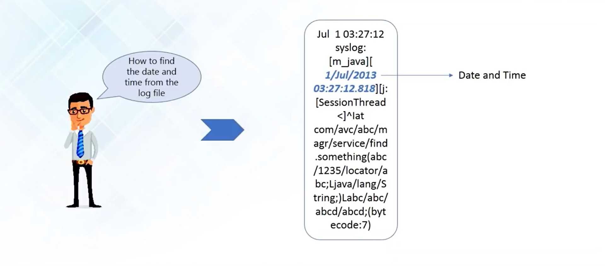
Why we use Regular Expressions ?

Slide 4
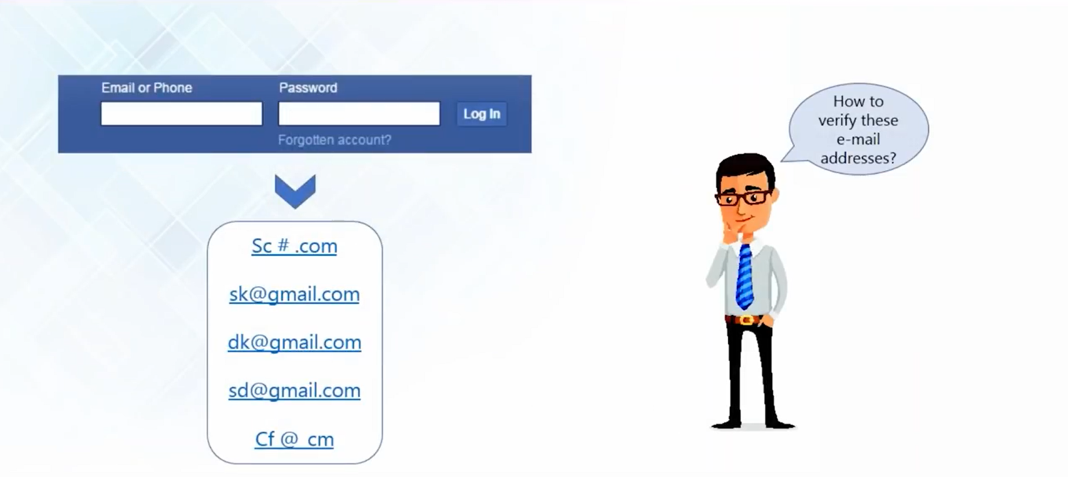
Why we use Regular Expressions ?

Slide 5
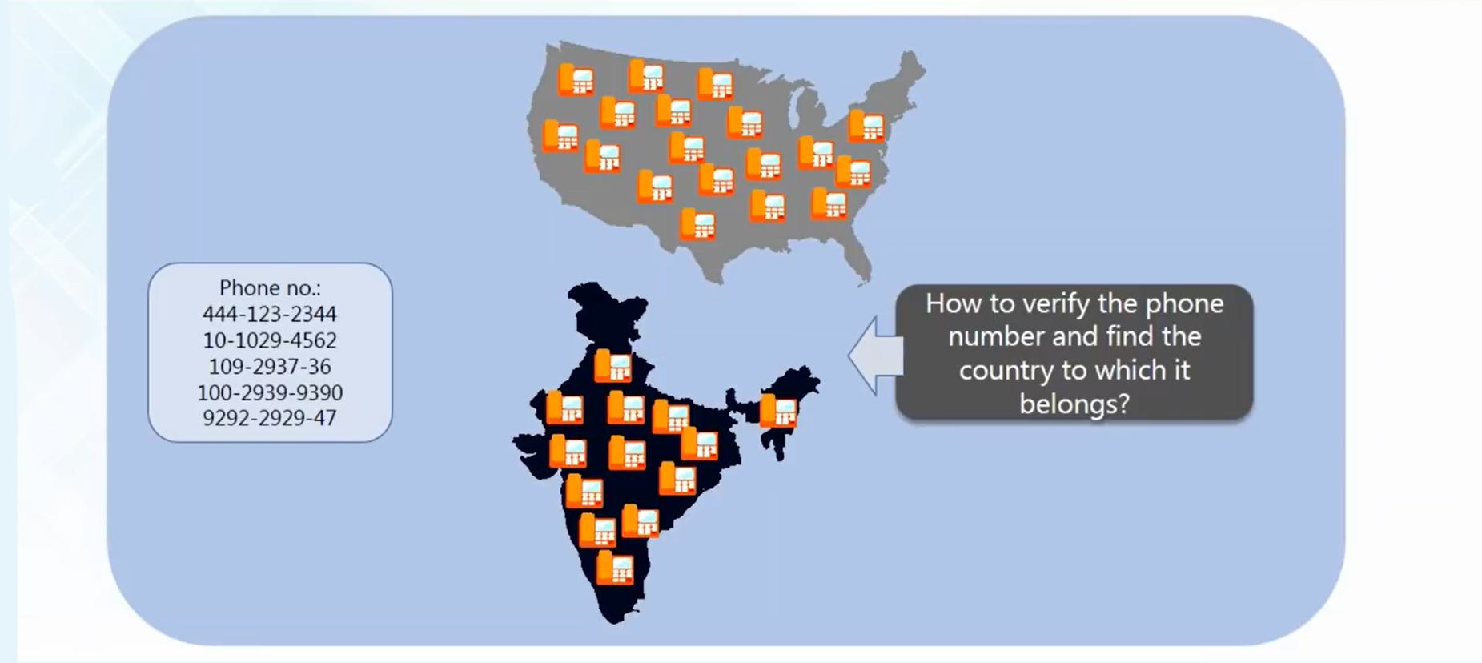
Why we use Regular Expressions ?

Slide 6
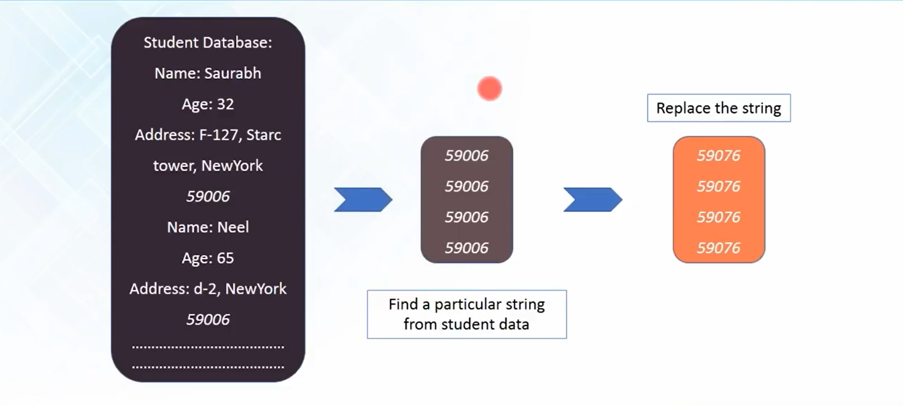
Why we use Regular Expressions ?

Slide 7
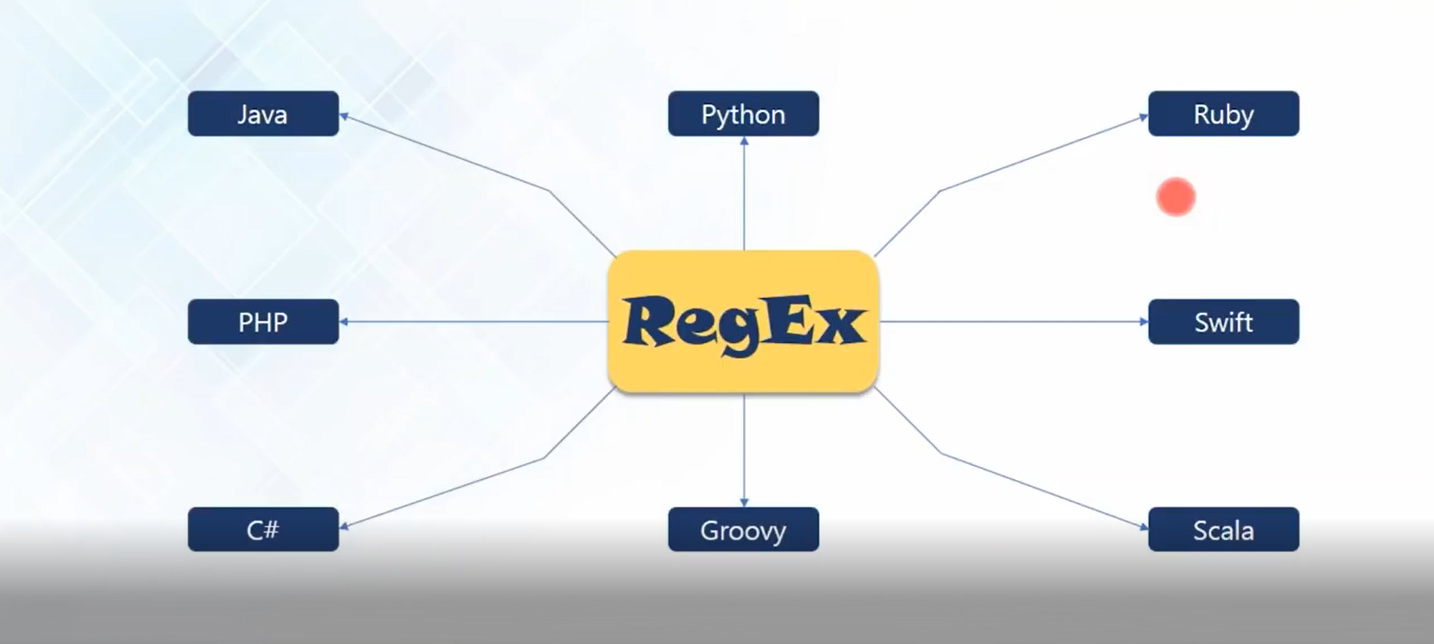
Regular Expressions: 8 different languages

Slide 8
What are Regular Expressions ?
A Regular Expression is a special text string for describing a search pattern
Can you identify the pattern to find the name and age ?
ages = re.findall(r’\d{1,3}’, NameAge)
Names = re.findall(r’[A-Z][a-z]*’, NameAge)
NameAge = “””
Bismi is 10 and Renuja is 20
Nisha is 24 and Ansu is 25”””
{‘Bismi’:’10’, ‘Renuja’:’20’, ‘Nisha’: ‘24’, ‘Ansu’: ‘25’}
First letter of all the Names is an uppercase letter and Age is represented by numbers

Slide 9
What are Regular Expressions ?
A regular expression is a special sequence of characters that helps you match or find other strings or sets of strings, using a specialized syntax held in a pattern.
The module re provides support for regular expressions in Python.
There are a total of 14 metacharacters.
To avoid any confusion while dealing with regular expressions, we would use Raw Strings as r'expression'.

Slide 10
What are Regular Expressions ?
Both the String and RegEx have their own cursor
B | E | E | R |  | I | S |  | N | I | C | E
TEXT
R | S | N
RegEx

Slide 11
Meta Characters in Regular Expressions
\ Used to drop the special meaning of character following it
[] Represent a character class
^ Matches the beginning
$ Matches the end
. Matches any character except newline
? Matches zero or one occurrence.
| Means OR (Matches with any of the characters separated by it.
* Any number of occurrences (including 0 occurrences)
+ One ore more occurrences
{} Indicate number of occurrences of a preceding RE to match.
() Enclose a group of REs

Slide 12
Regular Expression Operations
Find a word in a string
Generate an Iterator
Match one of many of several letters
Find a word in a string
import re allinform = re.findall("inform", "we need to inform him the latest information") for i in allinform: print(i)
Match series of range of characters
Replace string
Match a single character

Slide 13
Regular Expression Operations
Find a word in a string
Generate an Iterator
Match one of many of several letters
Get the starting and ending index of a string
Match series of range of characters
Replace string
Match a single character
import re string = "we need to inform him the latest information" for i in re.finditer("inform", string): locTuple = i.span() print(locTuple)

Slide 14
Regular Expression Operations
Find a word in a string
Generate an Iterator
Match one of many of several letters
Match words with a particular pattern
import re string = "Cat, Hat, Mat, Sat, Vat" allString = re.findall("[HSVMC]at", string) for i in allString: print(i)
Match series of range of characters
Replace string
Match a single character

Slide 15
Regular Expression Operations
Find a word in a string
Generate an Iterator
Match one of many of several letters
Match series of range of characters
import re string = "Cat, Hat, Mat, Sat, Vat" allString = re.findall("[H-S]at", string) #allString = re.findall("[^H-S]at", string) for i in allString: print(i)
Match series of range of characters
Replace string
Match a single character

Slide 16
Regular Expression Operations
Find a word in a string
Generate an Iterator
Match one of many of several letters
Replace a string
import re string = "Cat Hat Mat Rat Sat Vat" regex = re.compile("[R]at") subString = regex.sub("Dog", string) print(subString)
Match series of range of characters
Replace string
Match a single character

Slide 17
Regular Expression Operations
Find a word in a string
Generate an Iterator
Match one of many of several letters
Match a single character
import re string = '0123456789' #creates a list of 2 digit numbers in the string print("Matches : ", re.findall("\d{2}", string)) #creates a length of the list with 5 digit numbers in the string print("Matches : ", len(re.findall("\d{5}", string)))
Match series of range of characters
Replace string
Match a single character

Slide 18
Regular Expression Operations
Replace a string
import re string = '''Computer science is the study of the theory, experimentation, and engineering that form the basis for the design and use of computers.''' regex = re.compile("\n") subString = regex.sub(" ", string) print(subString)
# \b : backspace # \c : carriage return # \f : form feed # \t : tab space # \v : vertical tab

Slide 19
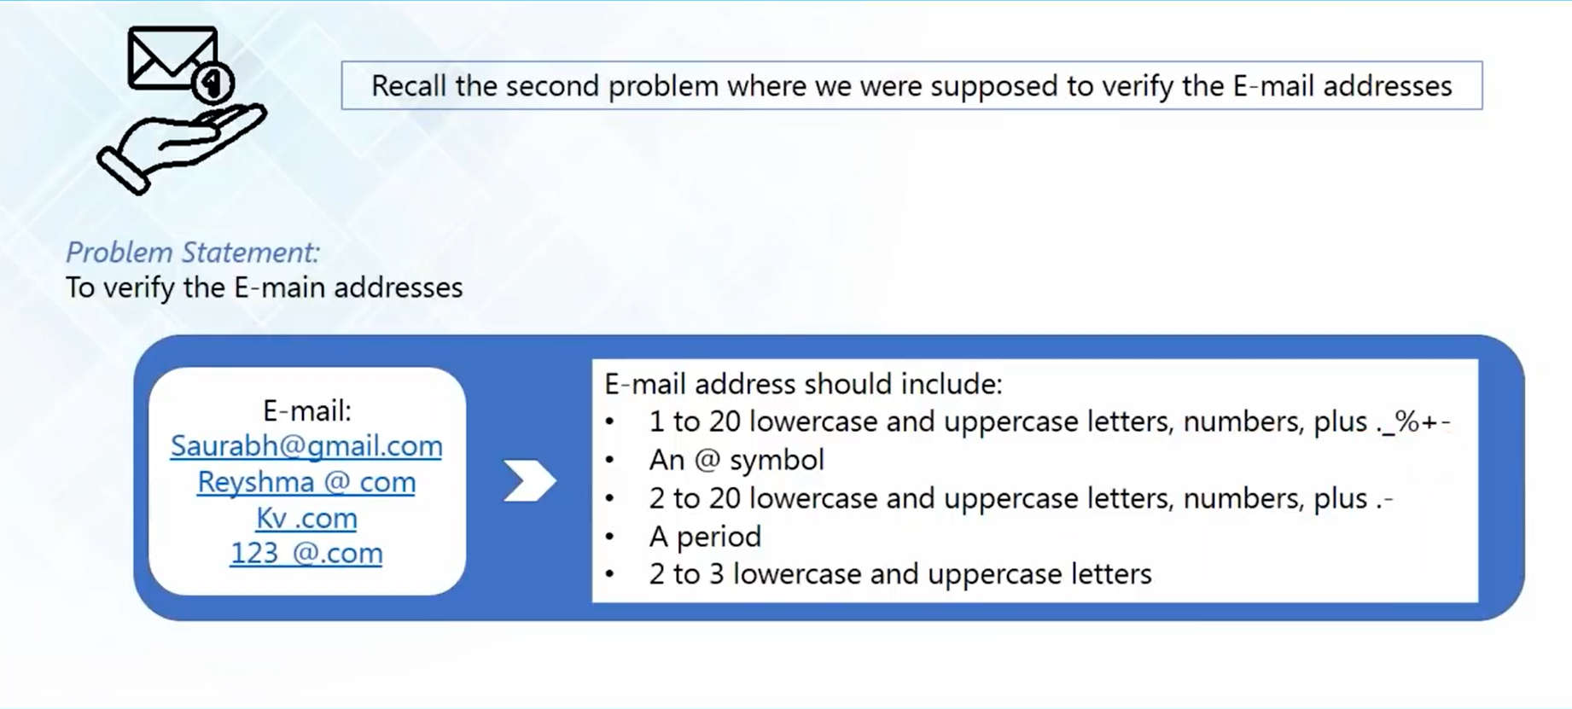
Email Verification

Slide 20
Email Verification
import re email1 = "abhijith@cyberdude.com" email2 = "noufila.l@gmail.co.uk" if re.search(r"(^[a-z0-9.]{2,20}@[a-z-]{2,20}(\.[a-z]{2,3}){1,2}$)", email): print("its a valid email")

Slide 21
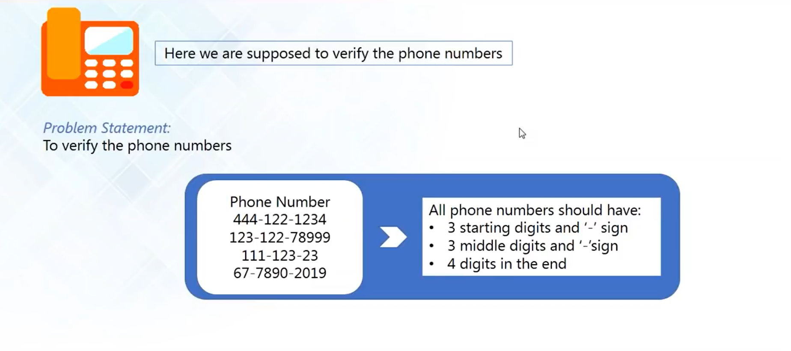
Phone Number Verification

Slide 22
Phone Number Verification
import re email1 = "abhijith@cyberdude.com" email2 = "noufila.l@gmail.co.uk" if re.search("[\w.]{2,20}@[\w.]{2,20}.[a-z]{2,3}", email1): print("its a valid email") if re.search("[\w.]{2,20}@[\w.]{2,20}.[a-z]{2,3}", email2): print("its a valid email")

Slide 23
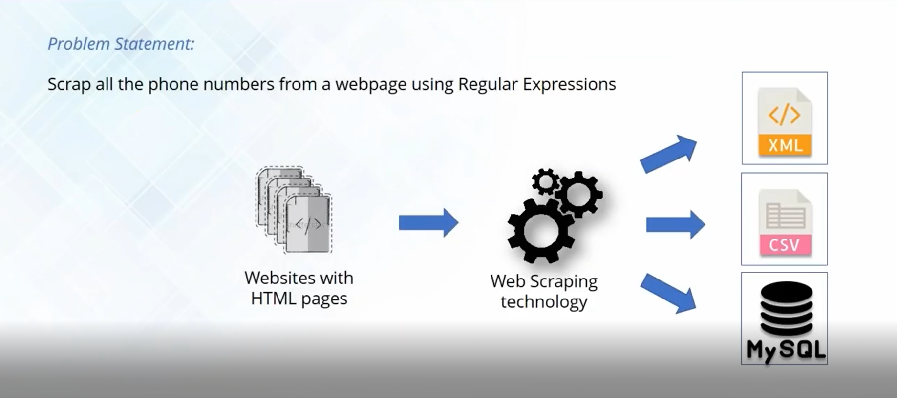
Web Scraping

Slide 24
Web Scraping
import re import urllib as u url = "http://www.corporationoftrivandrum.in/phone-numbers" # creates a response object <http.client.HTTPResponse object at 0x0C64A790> response = u.request.urlopen(url) #print(response) # generates the html code in binary encoded format html = response.read() # print(html) # generates the html code in formatted manner htmlStr = html.decode() # print(htmlStr) pdata = re.findall("0471-\d{7}|0471\d{7}|2\d{6}", htmlStr) for i in pdata: print(i)

Slide 25
compile Function
Regular expressions are compiled into pattern objects, which have methods for various operations such as searching for pattern matches or performing string substitutions.
import re
# compile() creates regular expression character class [a-e],
# which is equivalent to [abcde].
# class [abcde] will match with string with 'a', 'b', 'c', 'd', 'e'.
p = re.compile('[a-e]')
# findall() searches for the Regular Expression and return a list upon finding
print(p.findall("Aye, said Mr. Gibenson Stark"))

Slide 26
Output
['e', 'a', 'd', 'b', 'e', 'a’]
Understanding the Output: First occurrence is ‘e’ in “Aye” and not ‘A’, as it being Case Sensitive. Next Occurrence is ‘a’ in “said”, then ‘d’ in “said”, followed by ‘b’ and ‘e’ in “Gibenson”, the Last ‘a’ matches with “Stark”.
Metacharacter blackslash ‘\’ has a very important role as it signals various sequences. If the blackslash is to be used without its special meaning as metacharacter, use’\\’

Slide 27
\d Matches any decimal digit, this is equivalent to the set class [0-9].
\D Matches any non-digit character.
\s Matches any whitespace character.
\S Matches any non-whitespace character.
\w Matches any alphanumeric character, this is equivalent to the class [a-zA-Z0-9_].
\W Matches any non-alphanumeric character.

Slide 28
split Function
Split string by the occurrences of a character or a pattern, upon finding that pattern, the remaining characters from the string are returned as part of the resulting list.
Syntax :
re.split(pattern, string, maxsplit=0, flags=0)
The First parameter, pattern denotes the regular expression, string is the given string in which pattern will be searched for and in which splitting occurs, maxsplit if not provided is considered to be zero ‘0’, and if any nonzero value is provided, then at most that many splits occurs. If maxsplit = 1, then the string will split once only, resulting in a list of length 2. The flags are very useful and can help to shorten code, they are not necessary parameters, eg: flags = re.IGNORECASE, In this split, case will be ignored.

Slide 29
from re import split
# '\W+' denotes Non-Alphanumeric Characters or group of characters
# Upon finding ',' or whitespace ' ', the split(), splits the string from that point
print(split('\W+', 'Words, words , Words'))
print(split('\W+', "Word's words Words"))
# Here ':', ' ' ,',' are not Alphanumeric thus, the point where splitting occurs
print(split('\W+', 'On 12th Jan 2016, at 11:02 AM'))
# '\d+' denotes Numeric Characters or group of characters
# Splitting occurs at '12', '2016', '11', '02' only
print(split('\d+', 'On 12th Jan 2016, at 11:02 AM’))
Output
['Words', 'words', 'Words’]
['Word', 's', 'words', 'Words’]
['On', '12th', 'Jan', '2016', 'at', '11', '02', 'AM’]
['On ', 'th Jan ', ', at ', ':', ' AM']

Slide 30
import re
# Splitting will occurs only once, at '12', returned list will have length 2
print(re.split('\d+', 'On 12th Jan 2016, at 11:02 AM', 1))
# 'Boy' and 'boy' will be treated same when flags = re.IGNORECASE
print(re.split('[a-f]+', 'Aey, Boy oh boy, come here', flags = re.IGNORECASE))
print(re.split('[a-f]+', 'Aey, Boy oh boy, come here’))
Output
['On ', 'th Jan 2016, at 11:02 AM’]
['', 'y, ', 'oy oh ', 'oy, ', 'om', ' h', 'r', ‘’]
['A', 'y, Boy oh ', 'oy, ', 'om', ' h', 'r', '']

Slide 31
match Function
This function attempts to match RE pattern to string with optional flags
re.match(pattern, string, flags=0)
Pattern This is the regular expression to be matched.
String This is the string, which would be searched to match the pattern at the beginning of string.
Flags You can specify different flags using bitwise OR (|). These are modifiers, which are listed in the table below.

